Slide 1





Welcome
to our group project

Slide 2


Light-Dependent
Switch Circuit Using BJT
Group Name:
TIME TRAVELERS

Slide 3










Md. Forhaduzzaman Reyad
ID: 202316086
EECE-21 (B)
Osama Ahmed Ibrahim
ID: 202316126
EECE-21 (B)
Md. Zishan Kabir
ID: 202316097
EECE-21 (B)
Md. Abu Sayed Siddiqi
ID: 202316304
EECE-21 (B)
Team
Khalid Ibna Zahir
ID: 202316117
EECE-21 (B)
Member
Md Humaun Kabir Nahid
ID: 202216040
EECE-21 (B)
Md. Bayazid Hasan
ID: 202216036
EECE-21 (B)

Slide 4


ABSTRACT
This project is about making a simple circuit that can automatically turn a device on or off based on light levels. It uses a light sensor (LDR) to detect changes in brightness, and a transistor (BJT) to control the device. When it gets dark, the device turns on, and when it’s bright, it turns off. This circuit is useful for things like streetlights or energy-saving systems that work automatically based on light conditions.

Slide 5

Introduction
This project is about designing a circuit that can sense light and automatically control a device, like turning it on in the dark and off when it's bright. We use a light-dependent resistor (LDR) to detect light and a transistor (BJT) to act as a switch. The goal is to create a simple, useful system for controlling lights or other devices based on changes in the surrounding light. This type of circuit can be used in streetlights, night lights, and energy-saving devices.

Slide 6


GOALS AND OBJECTIVES
01
Design a light-sensitive circuit that automatically turns a device on or off based on ambient light conditions.
02
Use an LDR and BJT to create a simple and cost-effective switching mechanism for controlling devices like lights.
03
Demonstrate energy efficiency by ensuring the device operates only when necessary, such as turning off lights in bright conditions.
04
Explore real-life applications of the circuit, such as automatic street lighting and energy-saving systems for homes and businesses

Slide 7

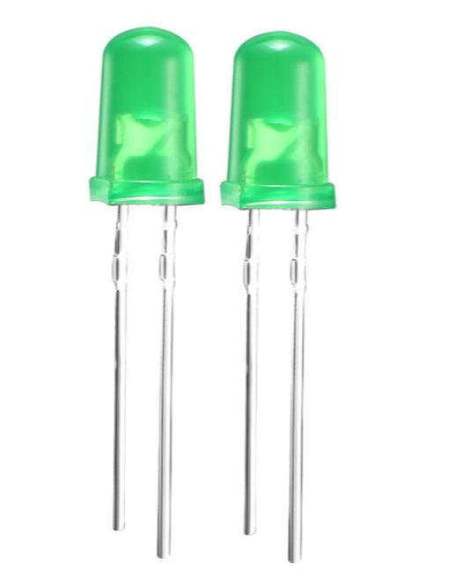
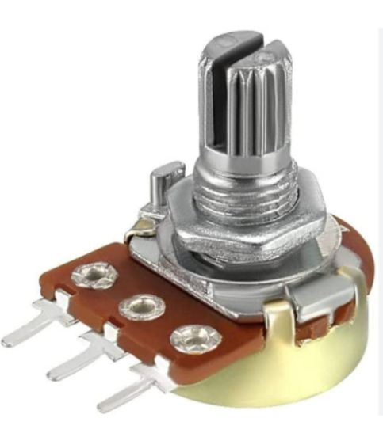
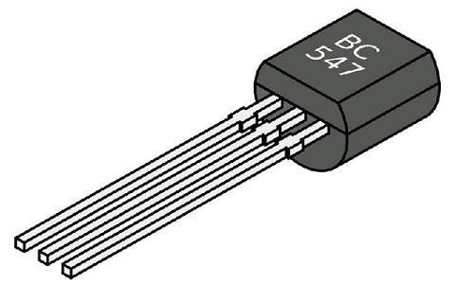
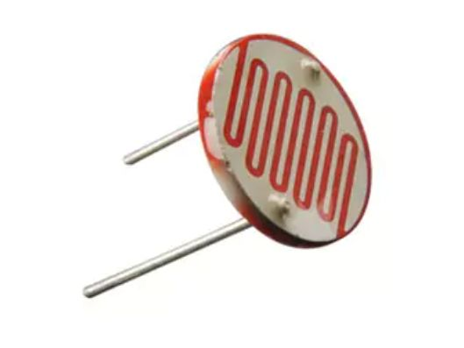


COMPONENTS
BJT
LDR
Bulb
Potentiometer
The BC547 is a small-signal NPN transistor used for switching and amplification. It operates with up to 45V and 100mA, offering a current gain of 110-800.
An LDR is a light-sensitive resistor that decreases resistance with more light. It's commonly used in light-activated devices like automatic lights and sensors.
An LED (Light Emitting Diode)isa semiconductor device that emits light when current flows through it. It’s efficient, long-lasting, and widely used in displays, indicators, and lighting.
A potentiometer is a variable resistor used to adjust voltage or control current. It’s commonly used for volume control, dimming lights, and tuning circuits.

Slide 8

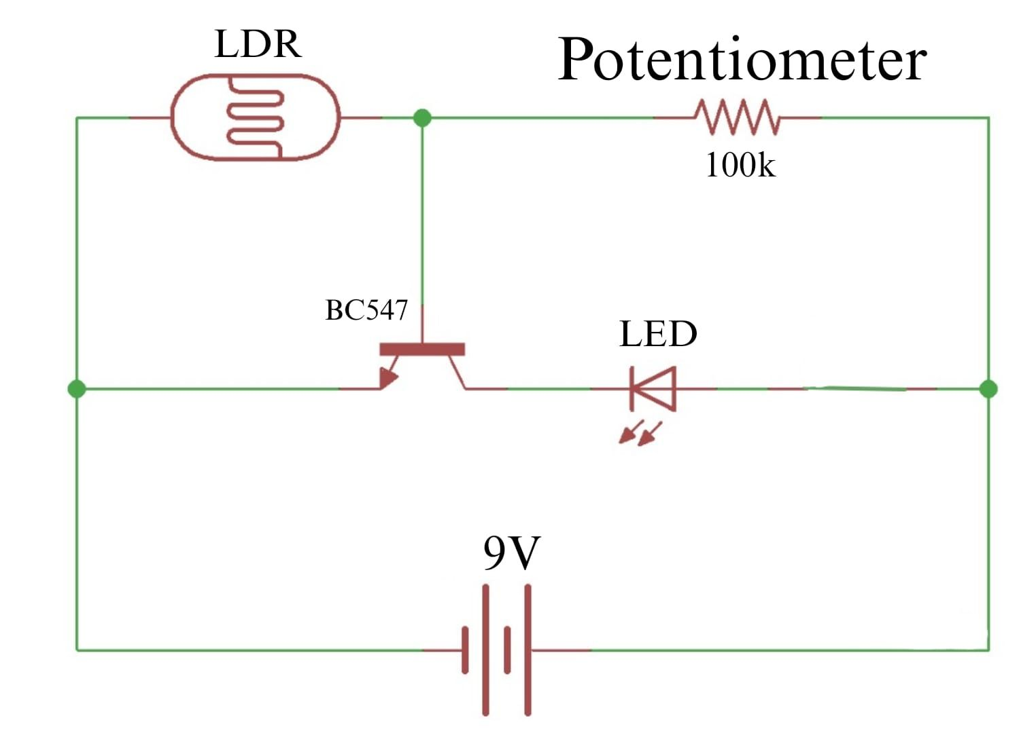
Circuit Diagram

Slide 9



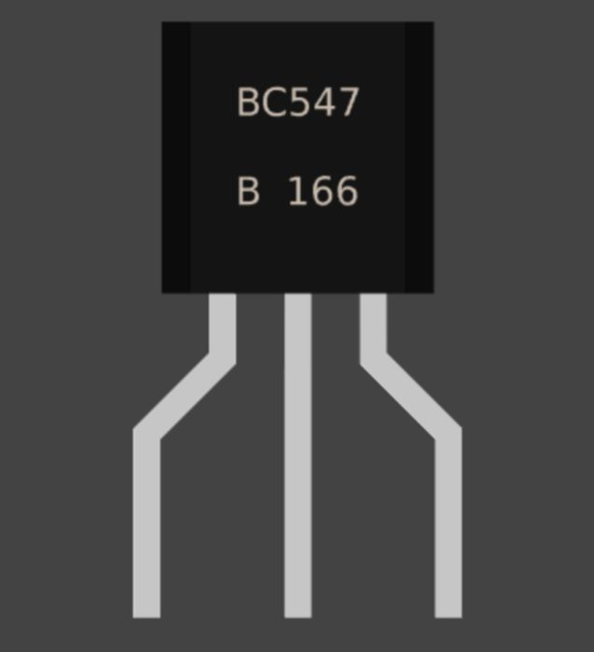


METHODOLOGY
LDR
Potentiometer
Finish
LDR senses light levels, increasing resistance in the dark and decreasing in brightness, triggering the circuit to control the device accordingly.
potentiometer adjusts the sensitivity of the LDR, allowing control over the light level at which the device turns on or off.
This project provides a simple, efficient way to automatically control a device based on light levels, ideal for applications like automatic lighting and energy-saving systems.
Light
BC547
Bulb
*Light intensity refers to the brightness level detected by the LDR in this project. It determines when the circuit will turn the device on or off based on ambient light conditions.
BC547 transistor acts as a switch, turning the device on when the LDR detects darkness and off when it senses brightness.
bulb is the output device that automatically turns on in darkness and off in brightness, based on the LDR's light detection.

Slide 10
Flow Chart :
Start
Power
Detect Ambient Light Level
Light
BORCELLE
If The Light Is Sufficient
If The Light Level is Low
Turn Device OFF
Turn Device ON

Slide 11
Importance and relevance of the project
The importance of this project lies in its ability to automate devices based on ambient light levels, improving energy efficiency and convenience. It's highly relevant for applications like automatic streetlights, security lighting, and energy-saving systems, reducing the need for manual operation and optimizing power usage based on environmental conditions.

Slide 12

CONCLUSION
In conclusion, this project successfully created a simple and effective circuit that automatically controls a device based on light levels using an LDR and BJT. The circuit responds to changes in ambient light, making it useful for practical applications like streetlights or energy-saving systems. It is a cost-efficient solution that works well for turning devices on in the dark and off in bright conditions, showing the potential for everyday use.

Slide 13





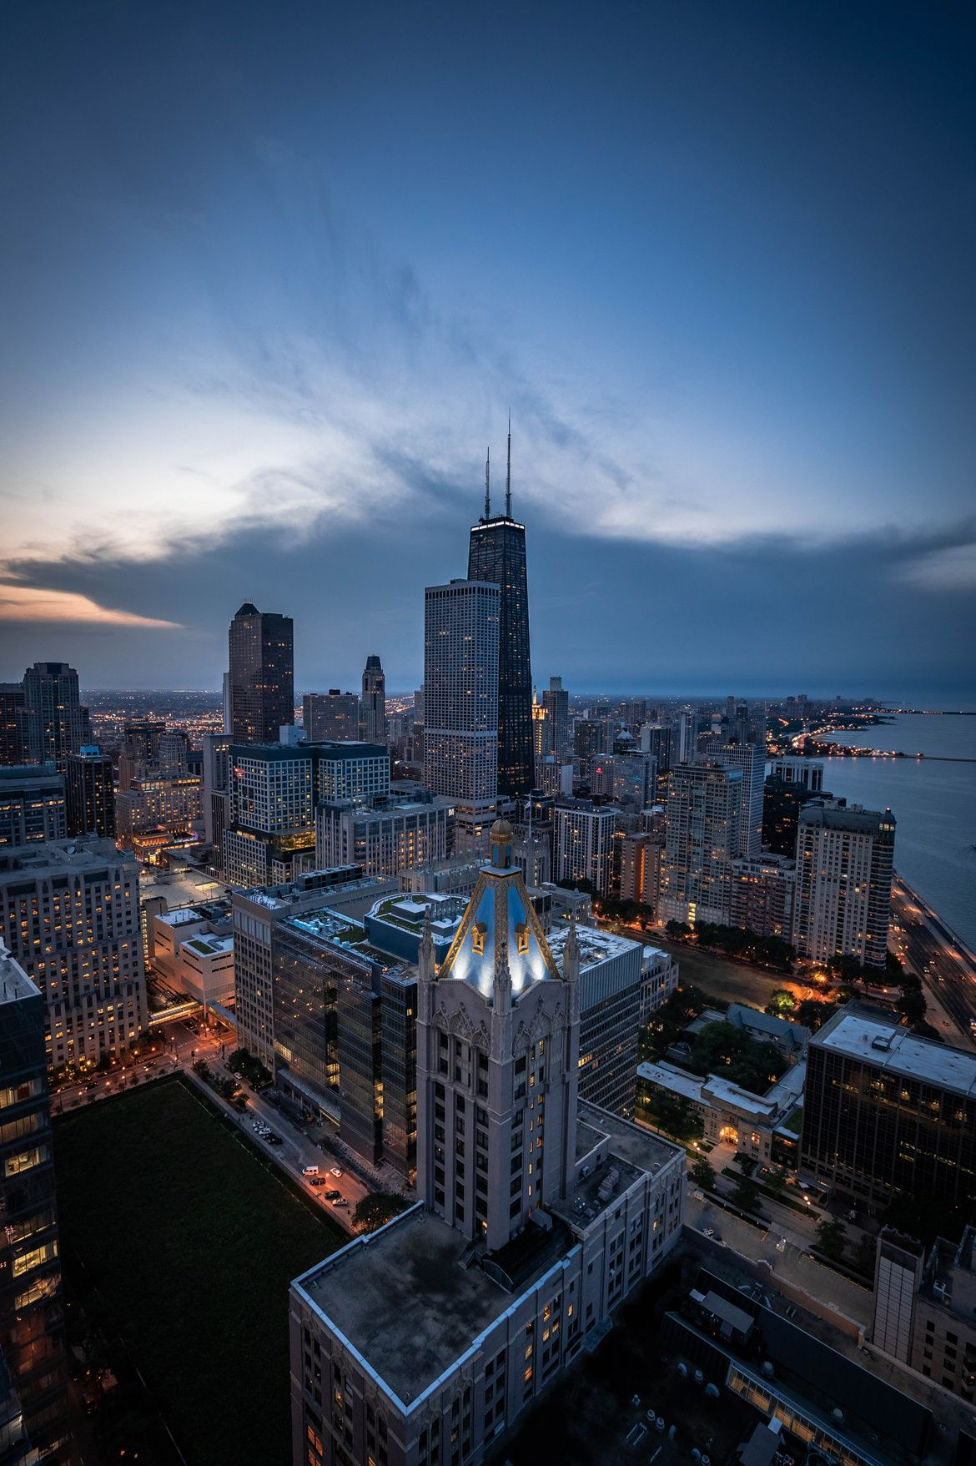
THANK YOU

